Slide 1


SENTIMENTPULSE
LIVE
By Team Spirit

Slide 2
TABLE OF CONTENTS
01
04
02
05
03
06
Team Member Roles and Responsibilities
Personas
Technologies
Problem Statement
Project Description
Algorithms

Slide 3
TABLE OF CONTENTS
07
09
08
10
Project Schedule
Retrospective
Team Agreement
Wikipage

Slide 4
01
Team Member Roles and Responsibilities
LIVE

Slide 5



Team Member Roles and Responsibilities
Sandhya Reddy Kallem
Yashwanth Thalla
Dhruv Maheshbhai Ranpariya
Frontend developer
Backend Developer
Frontend Developer

Slide 6


Team Member Roles and Responsibilities
Hema Durga Prasad Chittala
Sravan Kumar Ganji
Backend Developer
Machine Learning Enginner

Slide 7
02
Problem Statement
LIVE

Slide 8
Problem Statement
Today's constantly changing financial market often leaves the investors bombarded with unedited, undirected news from numerous sources thus it is hard for them to quickly understand the relevance and likely effect of such articles. Without a real-time sentiment analysis tool, investors will have to manually read the news which is a time-consuming, prejudiced, and exclusion of trading opportunities or wrong decisions can result. This missing automated tool for the determination of sentiment is the main cause of persistent decision-making hurry and hence affects the sole consistency of the trading behavior.

Slide 9
03
Project Description
LIVE

Slide 10
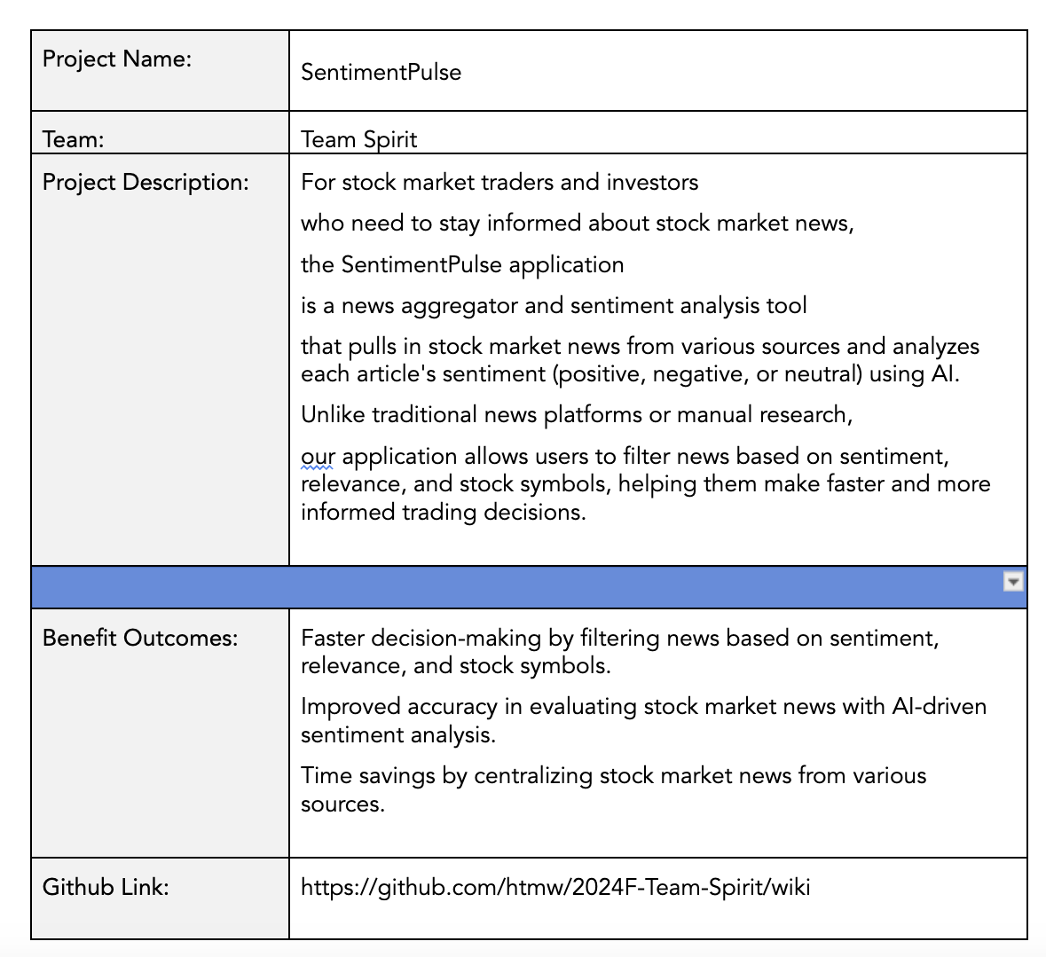
Project Description

Slide 11
04
PERSONAS
LIVE

Slide 12
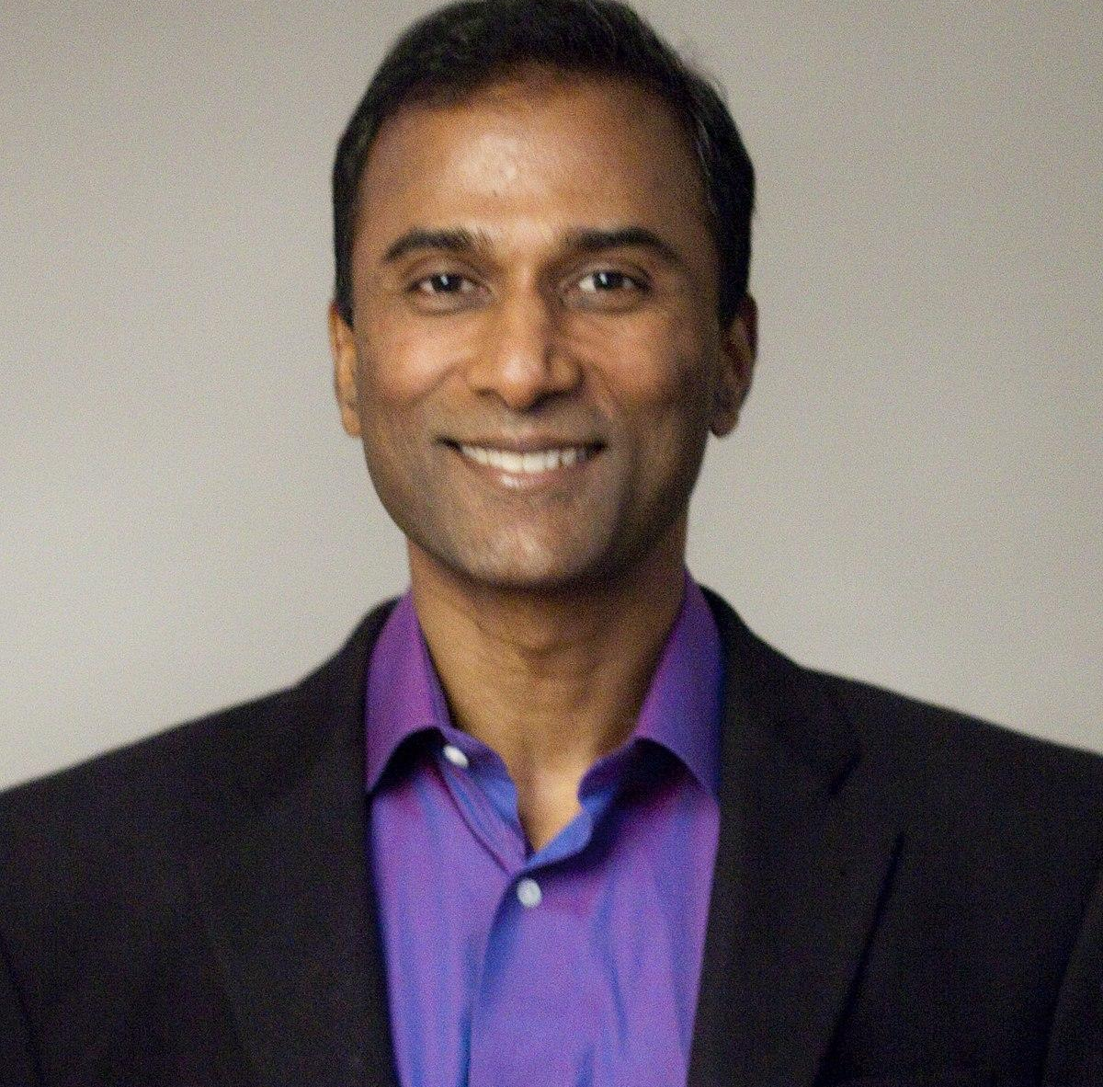
Rajesh Verma (India)
Age: 35
Occupation: Software Engineer
Experience with Investing: 5 years
Location: Bengaluru, India
Investment Strategy: Rajesh focuses on Indian stocks with occasional investments in U.S. tech stocks. He uses fundamental analysis and stays updated through financial news. However, he struggles to keep up with the sheer volume of news and seeks AI-driven tools to help quickly evaluate relevant stock-related information.
Goal: To make faster, data-driven decisions on stock purchases or sales, particularly for his tech-heavy portfolio, while balancing his work schedule.

Slide 13

Elsa Thompson (United States)
Age: 28
Occupation: Financial Analyst
Experience with Investing: 7 years
Location: New York, USA
Investment Strategy: Elsa tracks market trends, particularly in the energy and healthcare sectors. She relies on research and sentiment data to make informed decisions but finds it challenging to manually sift through a large volume of news. She needs an AI-driven platform to prioritize relevant news efficiently.
Goal: To improve her efficiency in analyzing news to make informed recommendations to clients and colleagues, while staying ahead of fast-moving market trends.

Slide 14

Lucas Müller (Germany, Europe)
Age: 45
Occupation: Independent Investor & Trader
Experience with Investing: 15 years
Location: Munich, Germany
Investment Strategy: Lucas focuses on European and U.S. stock markets, relying on global news to inform his decisions. He’s interested in using AI tools to assess the impact of international news on specific stocks, aiming to automate part of his decision-making process and reduce emotional trading.
Goal: To leverage AI-driven sentiment analysis to enhance his stock trading strategies and make faster, more informed decisions, particularly when reacting to international news.

Slide 15
05
Technologies

Slide 16
Technologies
Backend
Frontend
Database
Flask, Express JS
ReactJS
MongoDB
Machine Learning
API
Cloud Hosting
PyTorch, Huggingface
NewsAPI
GCP

Slide 17


Backend
What is it?
How is it used?
Flask is a lightweight Python web framework, and Express JS is a fast and minimalist web framework for Node.js.
Flask or Express JS will be used to handle backend logic, manage API requests, and serve data between the frontend and the database, enabling communication between the sentiment analysis AI and the stock market news aggregator.

Slide 18

Frontend
What is it?
How is it used?
ReactJS is a popular JavaScript library for building interactive user interfaces.
ReactJS will be used to build the web application's dynamic and responsive frontend, allowing users to interact with the platform, view stock market news, and access AI-driven sentiment insights.

Slide 19

DATABASE
What is it?
How is it used?
MongoDB is a NoSQL database designed for flexibility and scalability, storing data in JSON-like documents.
MongoDB will store news articles, user preferences, and AI-generated sentiment analysis, enabling fast retrieval and updates as new data comes in from the API.

Slide 20

Machine learning
What is it?
How is it used?
PyTorch is a machine learning framework, and Huggingface is a platform that provides pre-trained models and tools for NLP tasks.
PyTorch and Huggingface will be used to develop and deploy sentiment analysis models that process stock market news and classify the sentiment of each article (positive, neutral, or negative).

Slide 21
API
What is it?
How is it used?
NewsAPI is a service that provides access to news articles from various sources around the world.
NewsAPI will be integrated into the backend to pull relevant stock market news articles, which will be processed by the sentiment analysis model before being displayed to users.

Slide 22

Cloud Hosting
What is it?
How is it used?
Google Cloud Platform is a suite of cloud computing services that provides infrastructure for hosting applications.
GCP will host the web application, manage the backend servers, store data, and provide the resources necessary for running the machine learning models and API integrations efficiently.

Slide 23
06
Algorithm

Slide 24
Algorithm
What is BERT?
In what way is it applied?
BERT is an advanced Natural Language Processing (NLP) model developed by Google. It is formulated on the Transformer architecture and is devised to comprehend the context of a word in a sentence by studying it in both directions—left and right from the word—thus, it is very useful for sentiment analysis tasks, for example, understanding the sentiment of the text.
In the context of your project, BERT can be utilized through Huggingface to analyze stock market news articles and perform sentiment analysis. It will monitor the text and determine the sentiment(s) expressed in the news as positive, neutral, or negative. Therefore the technology enabling the categorization of each news piece and, consequently the provision of sentiment insights to the investors that quick assess of how the news may impact the stock performance. BERT's success in learning complex language patterns makes sentiment analysis more precise, which gives a more well-founded recommendation compared to the traditional NLP models.

Slide 25
07
Project Schedule
LIVE

Slide 26
Daily Standups
Weekly Sprint Planning
Sprint Retrospective
15 minutes for daily updates.
One hour to discuss the upcoming sprint and priorities.
At the end of each sprint to discuss what went well and what needs improvement.

Slide 27
All Sprints
Sprint 0
Sprint 1
Sprint 2
Sprint 3
09/26
10/24
11/21
12/12

Slide 28
08
Team Agreement
LIVE

Slide 29
Team Agreement
Meetings: Team meetings every Wednesday and Thursday at 7 PM.
Communication: Use Slack for daily communication and GitHub for code reviews.
Commitment: Each team member is responsible for completing tasks by their deadline.
Work Submission: Ensure all tasks are submitted for review at least 24 hours before deadlines.
Accountability: If a task cannot be completed, notify the team at least 48 hours in advance.
Collaboration: Help teammates if you finish your work early or if they are struggling.
Team Members
Sandhya Reddy Kallem
Dhruv Maheshbhai Ranpariya
Yashwanth Thalla
Hema Durga Prasad Chittala
Sravan Kumar Ganji

Slide 30
09
Retrospective
LIVE

Slide 31
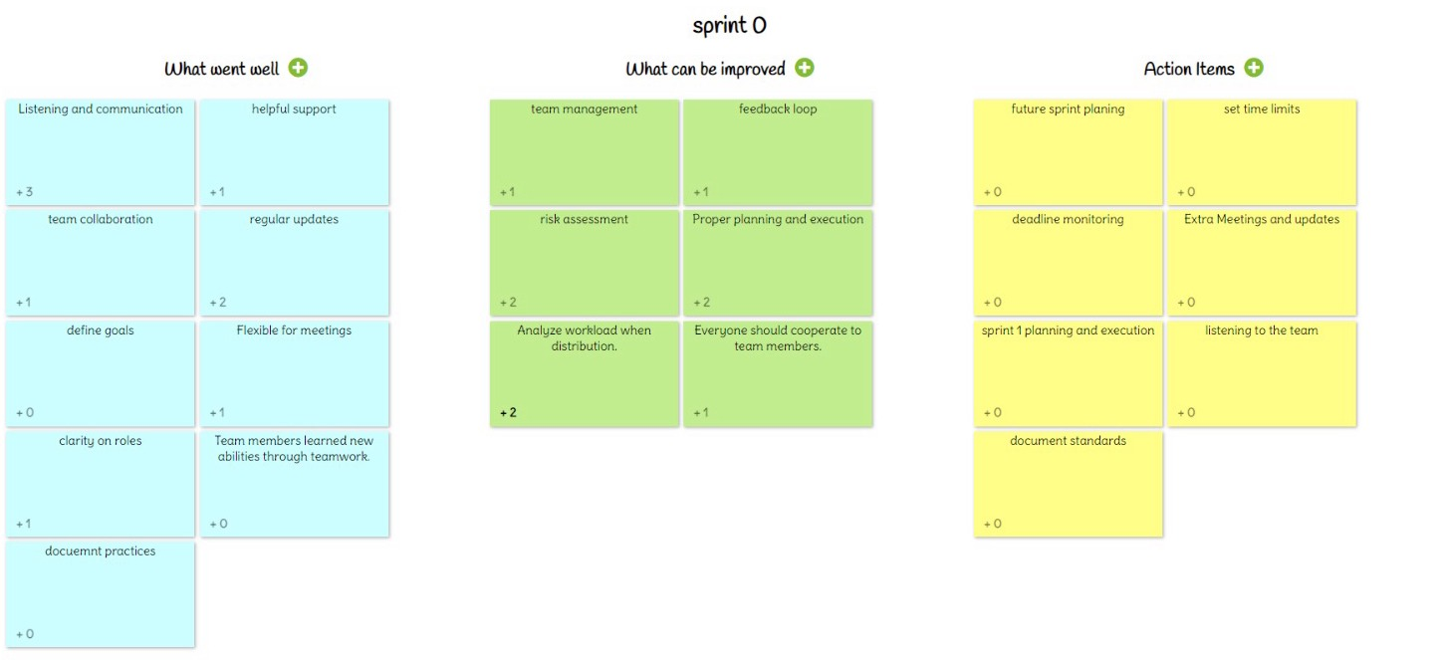
Retrospective

Slide 32
10
Wikipage Link
LIVE
https://github.com/htmw/2024F-Team-Spirit/wiki

Slide 33
Thank you

